Slide 1

Computer Graphics
CS C 471 and IS C 471
Dr. Lucy J. Gudino
Computer Science & Information Systems Group
Birla Institute of Technology & Science, Pilani, Goa Campus

Slide 2
Color Models
Notes:
RGB➔Monitors
YIQ➔ TV Broadcasting
CMY➔ Printer and Plotter

Slide 3
Introduction
Color is a psychophysical concept depending both upon the spectral distribution of the radiant energy of the illumination source and the visual sensations perceived by the viewer
Color perception depends mainly upon
  The physics of light
  The physiology of the visual system
Dominant frequecy decides the color of the object
Notes:
A light source produced by a sun or electric bulb emits all frequencies within the visible range to give white light. when this light is incident upon an object, some frequencies are absorbed and some are reflected by the object. The combination of reflected frequencies decides the color of the object. If the lower frequencies are predominant in the reflected frequencies, the object color is red. In this case, the perceived light has a dominant frequency at the red end of the spectrum. Therefore, the dominant frequency decides the colour of the object.

Slide 4
Contd..
Light is an electromagnetic wave. Its color is characterized by the wavelength content of the light.
  Different colors correspond to radiation of different wavelengths
  Intensity of each wavelength specified by amplitude
  Frequency = 2 pi/wavelength
Humans can detect light within visible wavelength
Visible light is an electromagnetic wave in the range 400 nm to 700 nm
Notes:
3.8 x 10^14 to 7.9 x 10^14 Hz

Slide 5
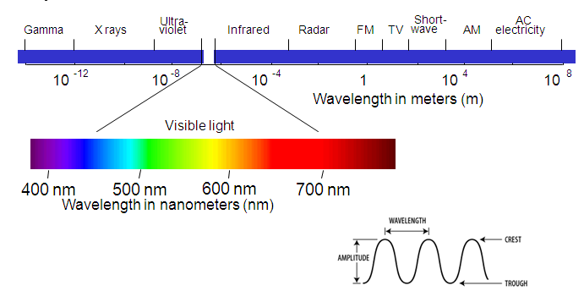
Contd…

Slide 6
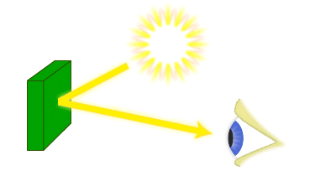
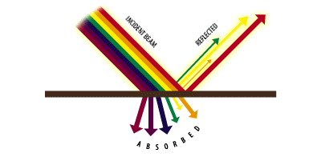
Source, Object, Observer
Reflected light = color of object
Notes:
Some or all of the light may be absorbed depending on the pigmentation of the object.

Slide 7
Contd…
If low frequencies are predominant in the reflected light → object is red
If high frequencies are predominant in the reflected light → object is violet

Slide 8
Properties of color
Three psychological color sensations
  Hue
  Saturation
  Brightness
hue: the color we see
Red to violet color
  Red ➔ low frequency : 3.8 x 10 ¹⁴ Hz
  Violet ➔ high frequency : 7.9 x 10 ¹⁴ Hz

Slide 9
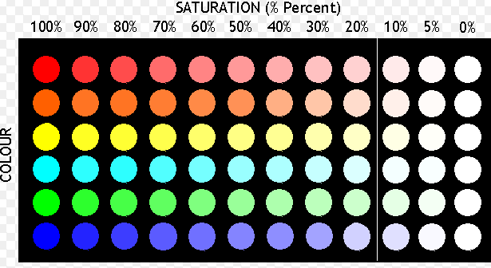
Contd..
saturation:
  Is also called purity
  It describes how close a light appears to be to a spectral color OR how far is the color from gray
  Pastles and pale colors have low purity and appear nearly white

Slide 10
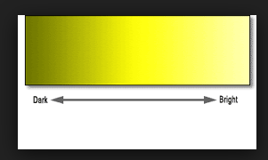
Contd…
Brightness:
  how bright is the color
  corresponds to the total light energy
  can be quanified as luminance of the light

Slide 11
Contd…
The term chromaticity is used to refer collectively to the two properties describing color characteristics : purity and dominant frequency (Hue)

Slide 12
Contd…
Most graphics displays used today generate color by mixing amounts of some built in red, green and blue colors
Questions to be answered
  Can color be quantified ?
  Can a color be uniquely defined ?
  How do the numerical descriptions relate to everyday ways of describing color?
  Is there a “common understanding” about colors ?

Slide 13
Contd.. Questions to be answered
  How does one compare colors?
  What range of colors can a CRT display or a printed page reveal?
  How can color lookup tables be loaded to produce the colors required?
    How do we deal with color palettes when a device can display only, say, 256 colors?

Slide 14
Color models

Slide 15
Color definitions
Complementary colors - two colors combine to produce white light
Primary colors - (two or) three colors used for describing other colors
Two main principles for mixing colors:
  additive mixing
  subtractive mixing

Slide 16
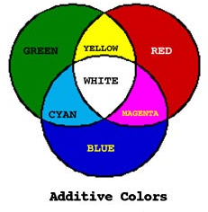
Additive Mixing
pure colors are put close to each other
overlapping gives yellow, cyan, magenta and white
the typical technique on color displays

Slide 17
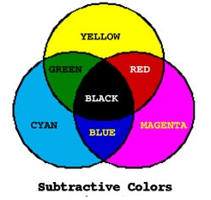
Subtractive mixing
Process of mixing light colors
Subtractive mixing is done by selectively removing certain colors
The three primary colors in subtractive mixing are yellow, magenta, and cyan.
In subtractive mixing of color, the absence of color is white and the presence of all three primary colors is black.
Used in printer

Slide 18
Contd…
In additive mixing source of color is “light”
In subtractive mixing source of color is “pigment” or “dye”

Slide 19
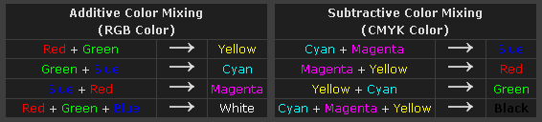
Contd…

Slide 20
Overview of color models
The human eye can perceive about 382000(!) different colors
A color model is specification of a 3D color coordinate system and a visible subset in the coordinate system within which all colors in a particular range lie.
Desirable approach : define a color with three fixed color

Slide 21
Contd…
  RGB color model
  CIE standard
  CMY color model (also, CMYK)
  HSV color model
  HLS color model

Slide 22
RGB Color Model
all colors are generated from the three primaries
various colors are obtained by changing the amount of each primary
additive mixing (r,g,b), 0≤(r,g,b)≤1
the RGB cube
1 bit/primary => 8 colors, 8 bits/primary => 16M colors

Slide 23

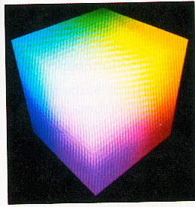
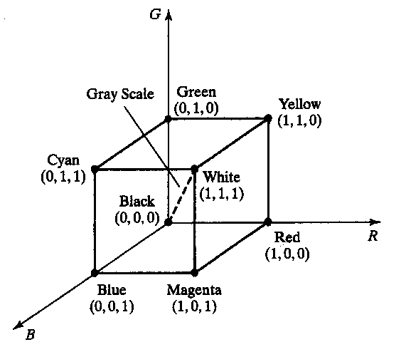
Contd…

Slide 24
Testing Color Response for RGB Model
To create the RGB color model, it is necessary to determine how much of each color component is needed to create all the dominant wavelengths in the visible spectrum.
This is done by projecting “pure” colors onto one screen, mixing amounts of R, G, and B on a neighboring screen, and asking a large number of people to say when the colors match.
Matching color C is expressed by
C = R*R + G*G + B*B
where R,G,B unit vectors and parameters R,G,B in the range 0 - 1

Slide 25
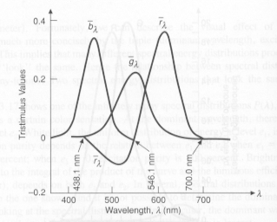
Contd…
Negative values for RED color matching function
Notes:
This graph shows the amounts of red, green, and blue light needed by an average observer to match color samples as they vary across the spectrum. (Luminance is kept constant.)
Colors in the vicinity of 500nm is obtained by subtracting red color from blue and green
RGB monitors cannot display colors in the neighborhood of 500nm

Slide 26
RGB Color on a Computer
The RGB color model works well for computers because it matches the technology of monitors.
On a color monitor, color is produced by exciting three adjacent dots made of red, green, and blue phosphors.
Because the dots are so small, they are blended into one color by the eye.
Note that the color is not blended by putting one color of light over another – it is blended by the eye.

Slide 27
Contd…
Not all colors perceivable by humans can be shown on a computer screen with the RGB model.
The same RGB values will not necessarily result in the same colors on two different monitors because monitors are not calibrated to a single standard.
RGB colors are not pure, saturated colors.
  This is because the kind of light emitted by an excited phosphor is not of a single wavelength, but has a spectral power distribution over a band of frequencies.

Slide 28
Disadvantages
RGB color matching demonstrates that not all visible colors can be represented with RGB as primaries. (You can’t add positive amounts of RGB to get all the colors. )
In some cases, you have to “take some color away” from the original sample being matched.
the RGB model is device dependent. That is different monitors use different R, G, and B colors of phosphors.
CIE standardization gives us a way to map between systems.
Notes:
The International Commission on Illumination (usually abbreviated CIE for its French name, Commission internationale de l'éclairage)
the RGB and CMYK models are device dependent. That is different monitors use different R, G, and B colors of phosphors. Different printers use different CMYK colors of ink.

Slide 29
CIE Chromaticity Diagram
CIE: International Commission on Illumination (Comission Internationale de l’Eclairage).
Also known as XYZ color model
Defined three standard primaries : X, Y and Z to replace red, green and blue color
X, Y and Z represent vectors in three dimensional additive color space
X, Y and Z are imaginary colors
Defined mathematically with positive color matching functions

Slide 30
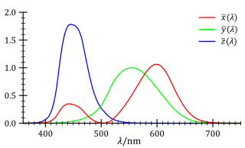

Slide 31
Contd…
Any color can be represented in the XYZ color space as an additive combination of the primaries using unit vectors X, Y,Z
  C(λ) = XX +YY+ZZ

Slide 32
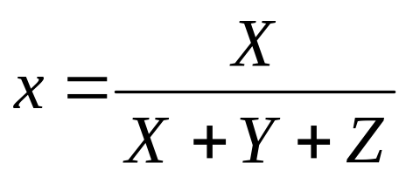
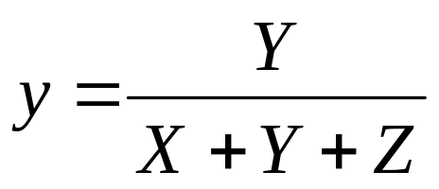
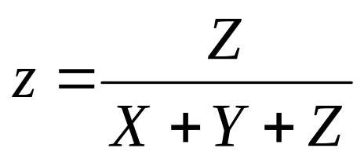
CIE Color Model
If we want to consider each component as a percentage of the total amount of light, we can “normalize” against luminance :
Note: X + Y + Z is the total amount of light energy.
Also note that x + y + z = 1
Notes:
X+Y+Z➔ luminance value and x+y+z =1
Any color can be represented with just x and y values (since z = 1-x-z)
Since we have nomalized against luminance, x and y represents the chromaticity values

Slide 33
Contd…
the concept of color can be divided into two parts: brightness and chromaticity.
Example: White and Grey color
  White ➔ bright color
  Grey ➔ less bright version of white
  Chromaticity of white and grey are same but brightness differs
Notes:
Since the human eye has three types of color sensors that respond to different ranges of wavelengths, a full plot of all visible colors is a three-dimensional figure. However, the concept of color can be divided into two parts: brightness and chromaticity. For example, the color white is a bright color, while the color grey is considered to be a less bright version of that same white. In other words, the chromaticity of white and grey are the same while their brightness differs.
The CIE XYZ color space was deliberately designed so that the Y parameter was a measure of the brightness orluminance of a color. The chromaticity of a color was then specified by the two derived parameters x and y, two of the three normalized values which are functions of all three tristimulus values X,Y, and Z:

Slide 34
Contd…
Any Color can be represented by using only x and y since x + y + z = 1
  Note : x and y values depend on hue and purity hence they are called chromaticity values
The CIE XYZ color space was deliberately designed so that the Y parameter was a measure of the brightness of a color.
  X = x/y Y Y = Y Z = z/y Y

Slide 35
The CIE Chromaticity Diagram
The derived color space specified by x, y, and Y is known as the CIE xyY color space and is widely used to specify colors in practice.
Is a tongue shaped curve obtained by plotting normalized values of x and y for colors in visible spectrum
This graph represents the hue and saturation(purity) of all colors in the visible spectrum. This is “chromaticity” information.

Slide 36
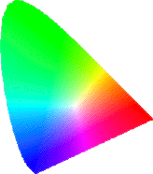
0.9
520
530
510
540
550
505
green
560
y
yellow-
green
570
500
0.5
580
yellow
495
590
orange
600
cyan
white
610
490
pink
red
650
485
magenta
blue
480
purple
470
450
0.0
0.5
1.0
x
Notes:
Point C is the white light point

Slide 37
Contd…
Uses of chromatic diagram
  Comparing color gamut(range) for different sets of primaries
  Indentifying complementary colors
  Determining purity and dominant wavelength for a color

Slide 38
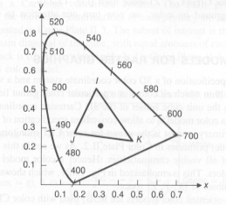
Color Gamuts Represented on CIE Diagram
All colors on the line IJ can be created by additively mixing colors I and J;
all colors in the triangle IJK can be created by mixing colors I, J, and K.

Slide 39
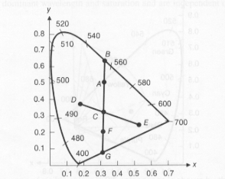
Dominant Wavelength on CIE Color Diagram
To determine the dominant wavelength of a color A from the diagram, draw a line between C (white) and the closest perimeter. The dominant wavelength is at B.
Note: this method will not work for color points that are between C and purple line

Slide 40
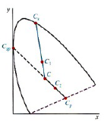
Contd…
C2 is non spectral color
Measure d_{c1} and d_{cs}
Findout purity as a ratio of
d_{c1} to d_{cs}
Notes:
Purity depends on the distance between c to C1 and C to Cs

Slide 41
The YIQ model
Basically used in television monitors
YIQ is the color model used for color TV in America (NTSC= National Television Systems Committee)
Y is luminance, I & Q are color (Hue and Purity)
  I contains orange cyan color info
  Q contains green magenta color info
  Note: Y is the same as CIE’s Y

Slide 42
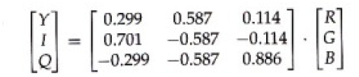

Transformation RGB, YIQ
y = 0.299R +0.587G +0.114B
I = R-Y
Q = B-Y

Slide 43
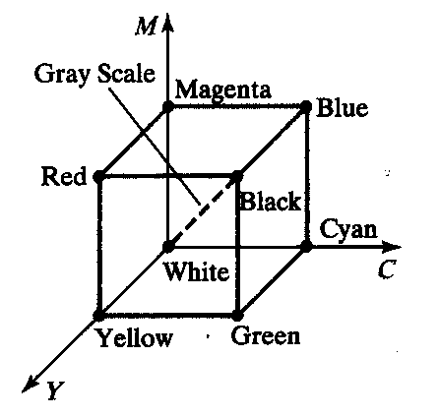
CMY Model
Subtractive color model
almost the same cube as with RGB;
the various colors are obtained by reducing light, e.g. if red is absorbed => green and blue are added, i.e cyan
(1,1,1) represents black, because all components of the incident light are subtracted

Slide 44
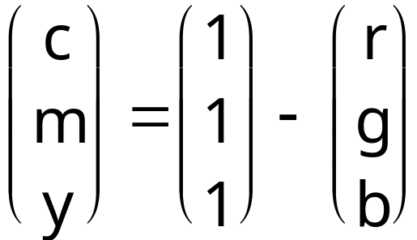
Transformation CMY and RGB

Slide 45
CMYK
For printing and graphics art industry, CMY is not enough; a fourth primary, K which stands for black, is added.
Conversions between RGB and CMYK are possible, although they require some extra processing.

Slide 46
HSV/HSB color model
This color model is based on polar coordinates, not Cartesian coordinates.
described by a hexcone derived from the RGB cube
HSV stands for Hue-Saturation-Value
  Hue: quantity that distinguishes color family, say red from yellow, green from blue
  Saturation (Chroma): color intensity (strong to weak). Intensity of distinctive hue, or degree of color sensation from that of white or grey
  Value (luminance): light color or dark color
  B → brightness

Slide 47
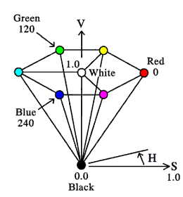
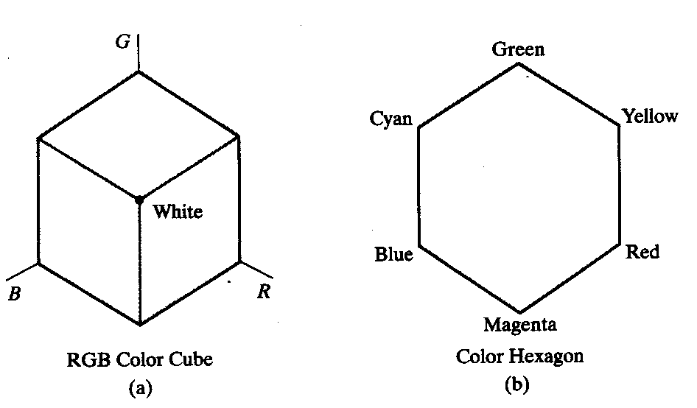
HSV color model

Slide 48
Hue is represented as an angle
Saturation s is used between 0 to 1
  S = 1 ➔ pure color
  Decreasing s ➔ gray scale
Value V varies from 0 at the apex of the hexcone to 1.0 at the top plane
  Apex of the hexcone is the black point
  At the top plane colors have their maximum intensity

Slide 49
Contd…
When S= 1.0 and V = 1.0 ➔ pure color
When V = 1.0 and S = 0 ➔ white point

Slide 50
Reading Assignment
HLS color model

Slide 51
Human Vision
The eye works like a camera, with the lens focusing an image onto the retina (upside-down and left-right reversed).
  The retina consists of an array of rods and three kinds of cones.
  The rods come into play when light levels are low and produce an image in shades of gray
  For higher light levels, the cones each produce a signal.
  Because of their differing pigments, the three kinds of cones (L, M and S) are most sensitive to red (R – 610 nm), green (G-560nm), and blue (B-430nm) light.
Notes:
Average observer

Slide 52
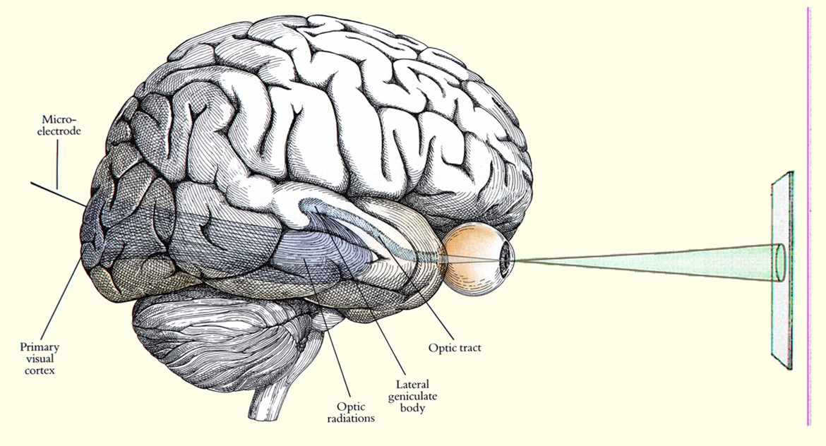
The Physiology of Human Vision

Slide 53
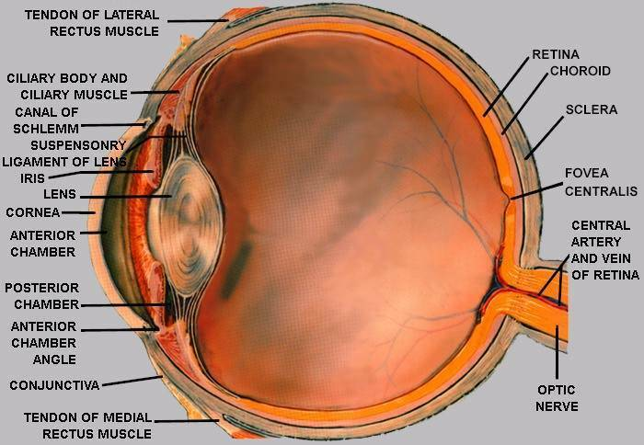
The Human Eye

Slide 54
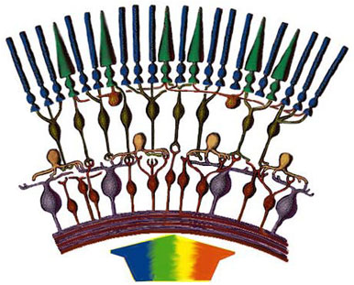
The Human Retina
rods
cones
bipolar
horizontal
amacrine
ganglion
light

